Slide 1
UI/UX Worksheet
Project Title
PetMatch
Team members
6530262 Min Myint Moh Soe
6530289 Sai Oum Maing
6622085 Min Htet
6520102 Aung Bhone Naing
6530198 Heang Mengtry

Slide 2
Day 7

Slide 3
Individual assignment: Wireframing in Figma (1) (5%)
60 mins
Objective
To understand and be able to use Figma application to create the wireframes.
Instructions
For each team member, use Figma and “Impakt Wireframe Kit” template (or other templates) to create an important wireframe that you think is important in solving the user’s problem.
Once finished, insert picture, name of creator, annotations, short descriptions of wireframe in your worksheet.
Note:
A team is required to have at least 4 main wireframes.
You can insert more slides in the worksheet (if any).

Slide 4

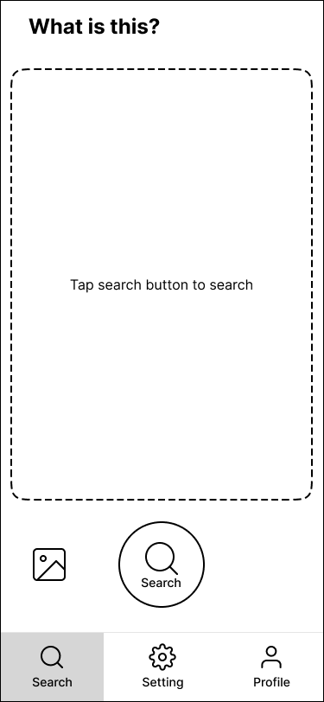
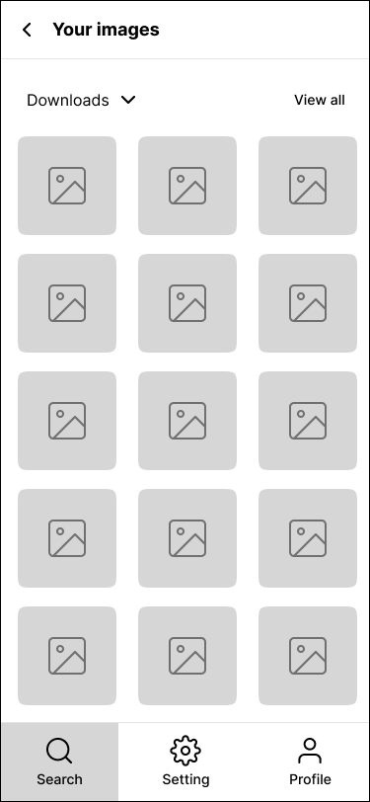
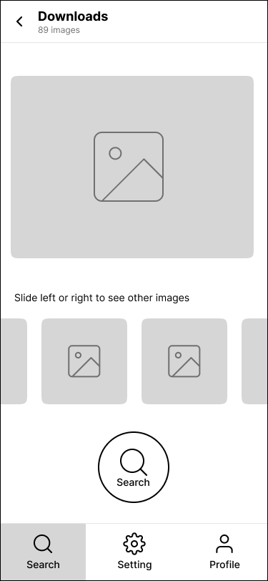
Main wireframe (example 1)
Show all pictures from all albums
Select desirable album
Select picture for searching
Slide to see other pictures in the album
Select picture from photo album
Click this button to take picture and search
Click this button to search by selected picture
Search menu
User can search by taking a picture.
(6615000 John Smith)
User can search by picture in photo album.
(6615000 John Smith)

Slide 5
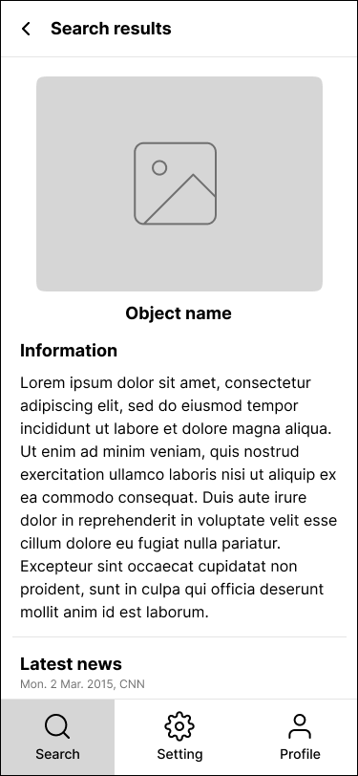
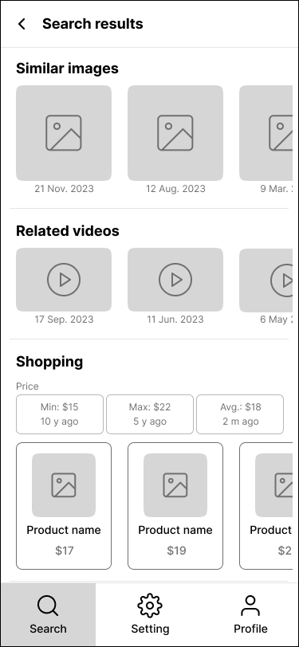
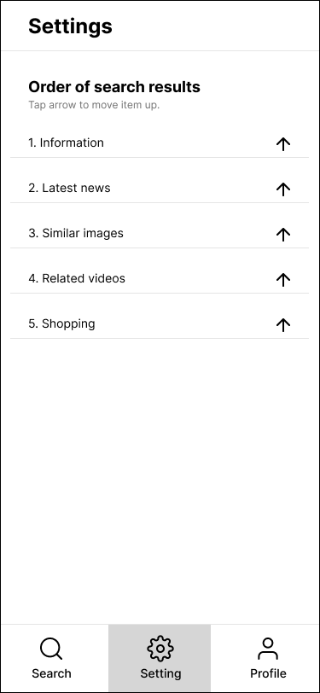
Main wireframe (example 2)
Similar images sorted by date in descending order.
Order of search results
Name of searched item
Related videos sorted by date in descending order.
Use AI to search, collect, and summarize information, such as origin, history, story, and so on.
Click to change the order.
Shops that sell searched item. It provides min price, max price, and average price.
Setting menu
Latest news of searched item.
Search results
(6615000 John Smith)
Search results
(6615000 John Smith)
Setting of search results
(6615000 John Smith)

Slide 6
Individual assignment: Wireframing in Figma (1)
Grading Criteria
0 = No submission
1 = Wireframe is incomplete or is subjective.
3 = Wireframe is complete but is not explained or annotated.
5 = Wireframe is complete, clearly explained, and clearly annotated.

Slide 7
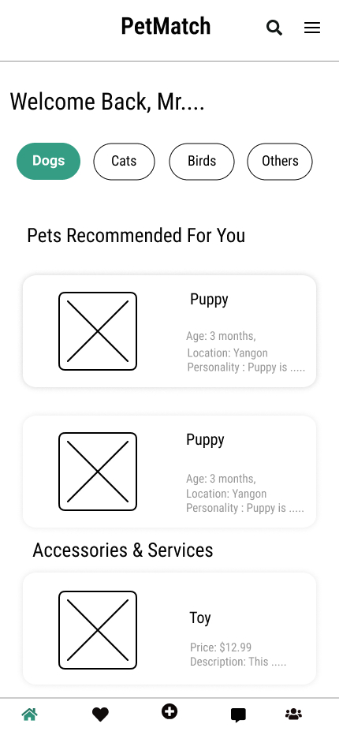
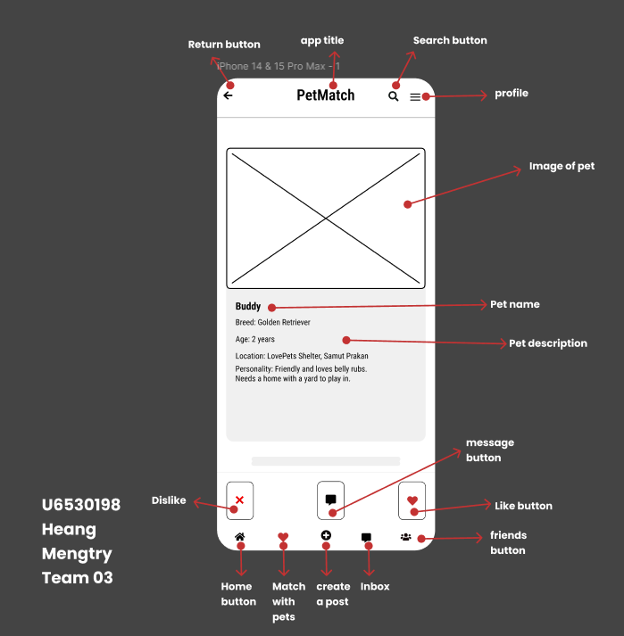
Main wireframe (1)
App Title
Search Button
Sub-title
Profile Button
Pet Category Filters To Search
Product Title
Pet Profiles
Product descriptions
Find Match Button
Create Post Button
Product Title
Product profiles
Chat Inbox Button
Green color used for Current Page
Friends and Followers Button
Short description
(Creator ID and Name)
Home Page
(Min Myint Moh Soe : ID6530262)
Notes:
6530262=5
6530198=5

Slide 8
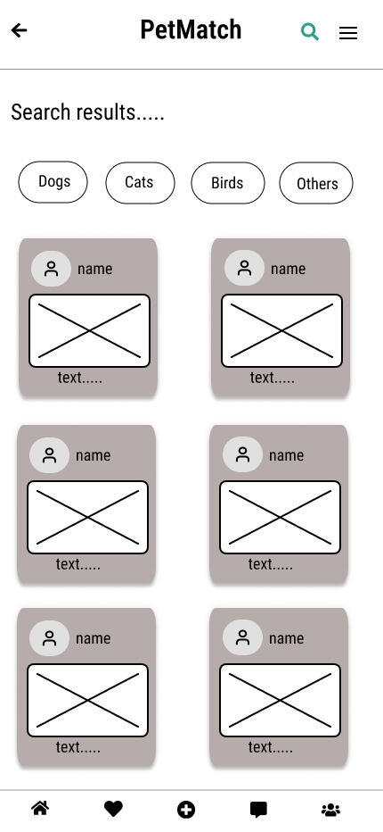
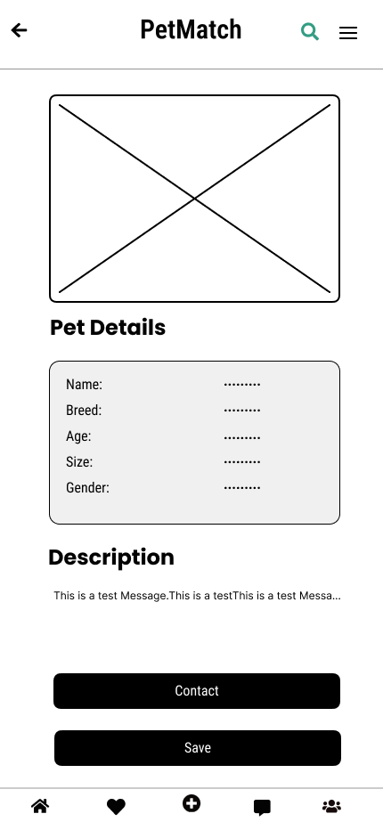
Main wireframe (2)
Search button
Profile button
App Title
App Title
Return Button
Profile Button
Return button
Name of searched results
Pet category Filters to search
Pet name
Pet Image
Green color used for current on searched page
Pet image
Pet details
Pet details Title
Details of pet
Description title
Description of Pet
Contact button
Save Button
Friends and followers button
Home Button
Home Button
Friends and followers
Find Match Button
Chat inbox button
Find match button
Create post button
Chat inbox button
Create Post Button
ID: 6520102
Name: Aung Bhone Naing
Id -6622085
Name- Min Htet
ID: 6520102
Name: Aung Bhone Naing
Notes:
6622085=5
6520102=5

Slide 9
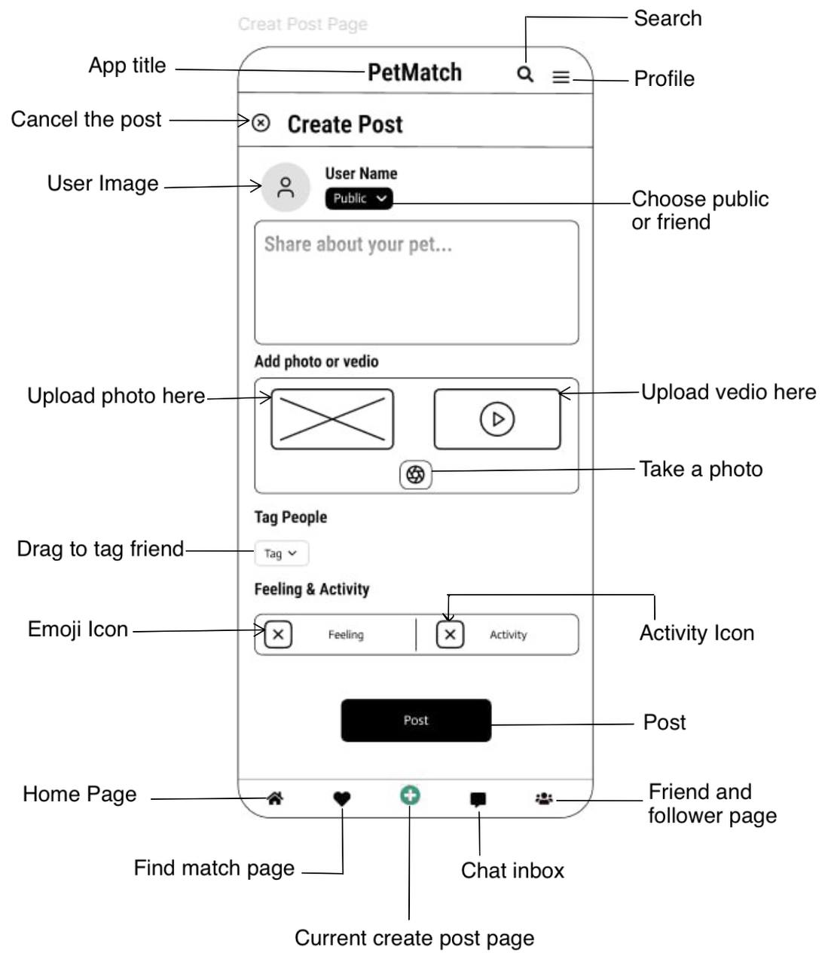
Main wireframe (3)
Create Post Page
Sai Oum Maing , ID - 6530289
Notes:
6530289=5

